Slide 1
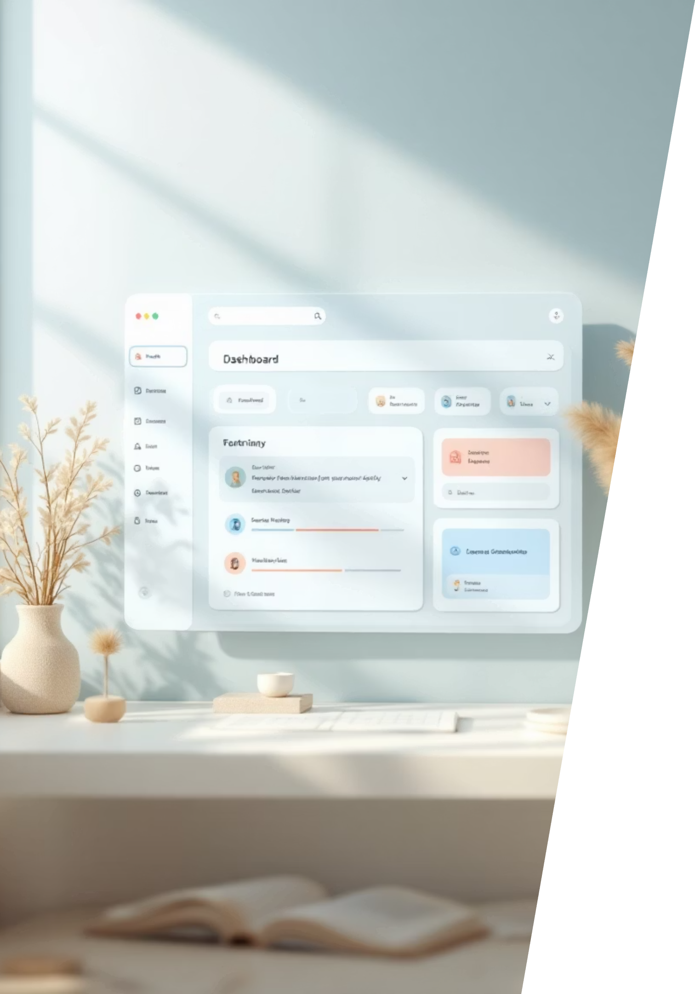



Task Management Tool
Productive Workflow Redesign
A comprehensive UX redesign focused on simplifying workflows, reducing cognitive load, and empowering users to accomplish more with less friction.

Slide 2



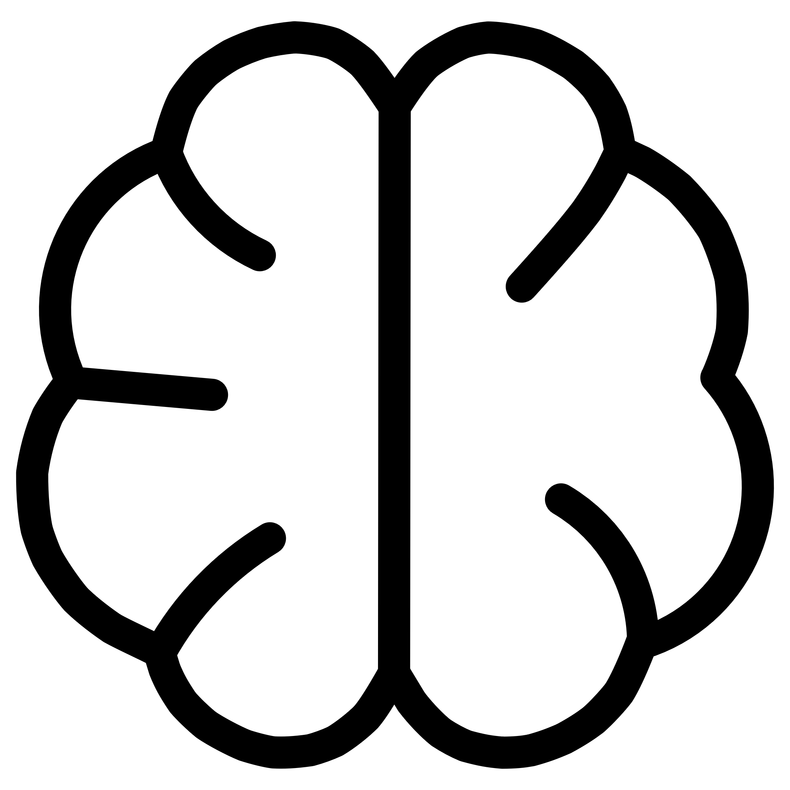



Introduction
The Challenge
Modern professionals juggle dozens of tasks daily, yet most productivity tools add complexity instead of clarity. Our redesign transforms task management into an intuitive, stress-free experience.
Simplify Management
Streamlined workflows that eliminate unnecessary steps
Reduce Cognitive Load
Clean interfaces that minimize mental effort
Structured Workflow
Clear organization that keeps users focused

Slide 3


Problem Statement
Users lose track of tasks due to cluttered UI structures that lead to stress and decreased productivity.
Lost Tasks
Increased Stress
Critical items buried in overcomplicated interfaces
Visual chaos creates anxiety and decision fatigue
Reduced Output
Time wasted navigating tools instead of completing work

Slide 4



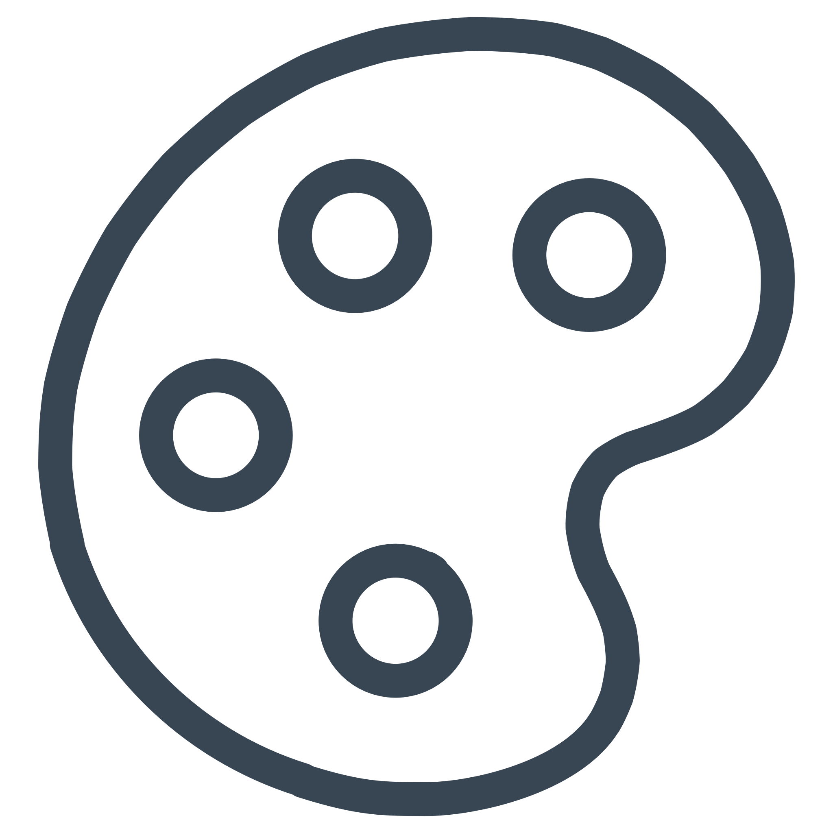


User Research
Research Methods
Key Insights
We conducted comprehensive user surveys and competitive analysis across leading platforms including Notion, Todoist, and Trello to understand user needs and industry standards.
Minimal Design Wins
Clean interfaces directly correlate with improved productivity and reduced cognitive load
Calendar Integration Essential
Users need seamless time-task connections to plan effectively
Color-Coded Priorities
Visual priority systems help users focus on what matters most
Smart Reminders
Context-aware notifications linked directly to tasks improve completion rates

Slide 5




Information Architecture
A thoughtfully structured navigation system that provides immediate access to core functionality while maintaining simplicity.
Dashboard
Tasks
Calendar
Central hub with today's priorities and quick overview
Complete task management with filtering and sorting
Time-based view of scheduled tasks and deadlines
Categories
Profile
Organize work by projects, contexts, or custom labels
Settings, preferences, and productivity analytics

Slide 6
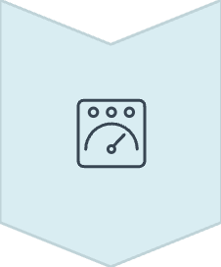







User Flow & Journey
Adding a New Task — Optimized for One-Tap Efficiency
Dashboard Entry
User starts from main view
Add Task
Quick access button initiates creation
Set Priority & Date
Assign urgency level and schedule
Save Task
Confirm and store task details
Calendar Sync
Task automatically appears in calendar view
Design Principle: Every interaction should feel effortless. The entire flow requires minimal taps and provides instant visual feedback at each step.

Slide 7


Wireframes
Foundation for Hierarchy & Readability
Task List View
Filters & Categories
Vertical layout with clear visual separation between tasks
Chip-based navigation for quick filtering
Calendar Home Screen
Task Creation Form
Integrated timeline showing tasks mapped to dates
Progressive disclosure design minimizes initial complexity

Slide 8
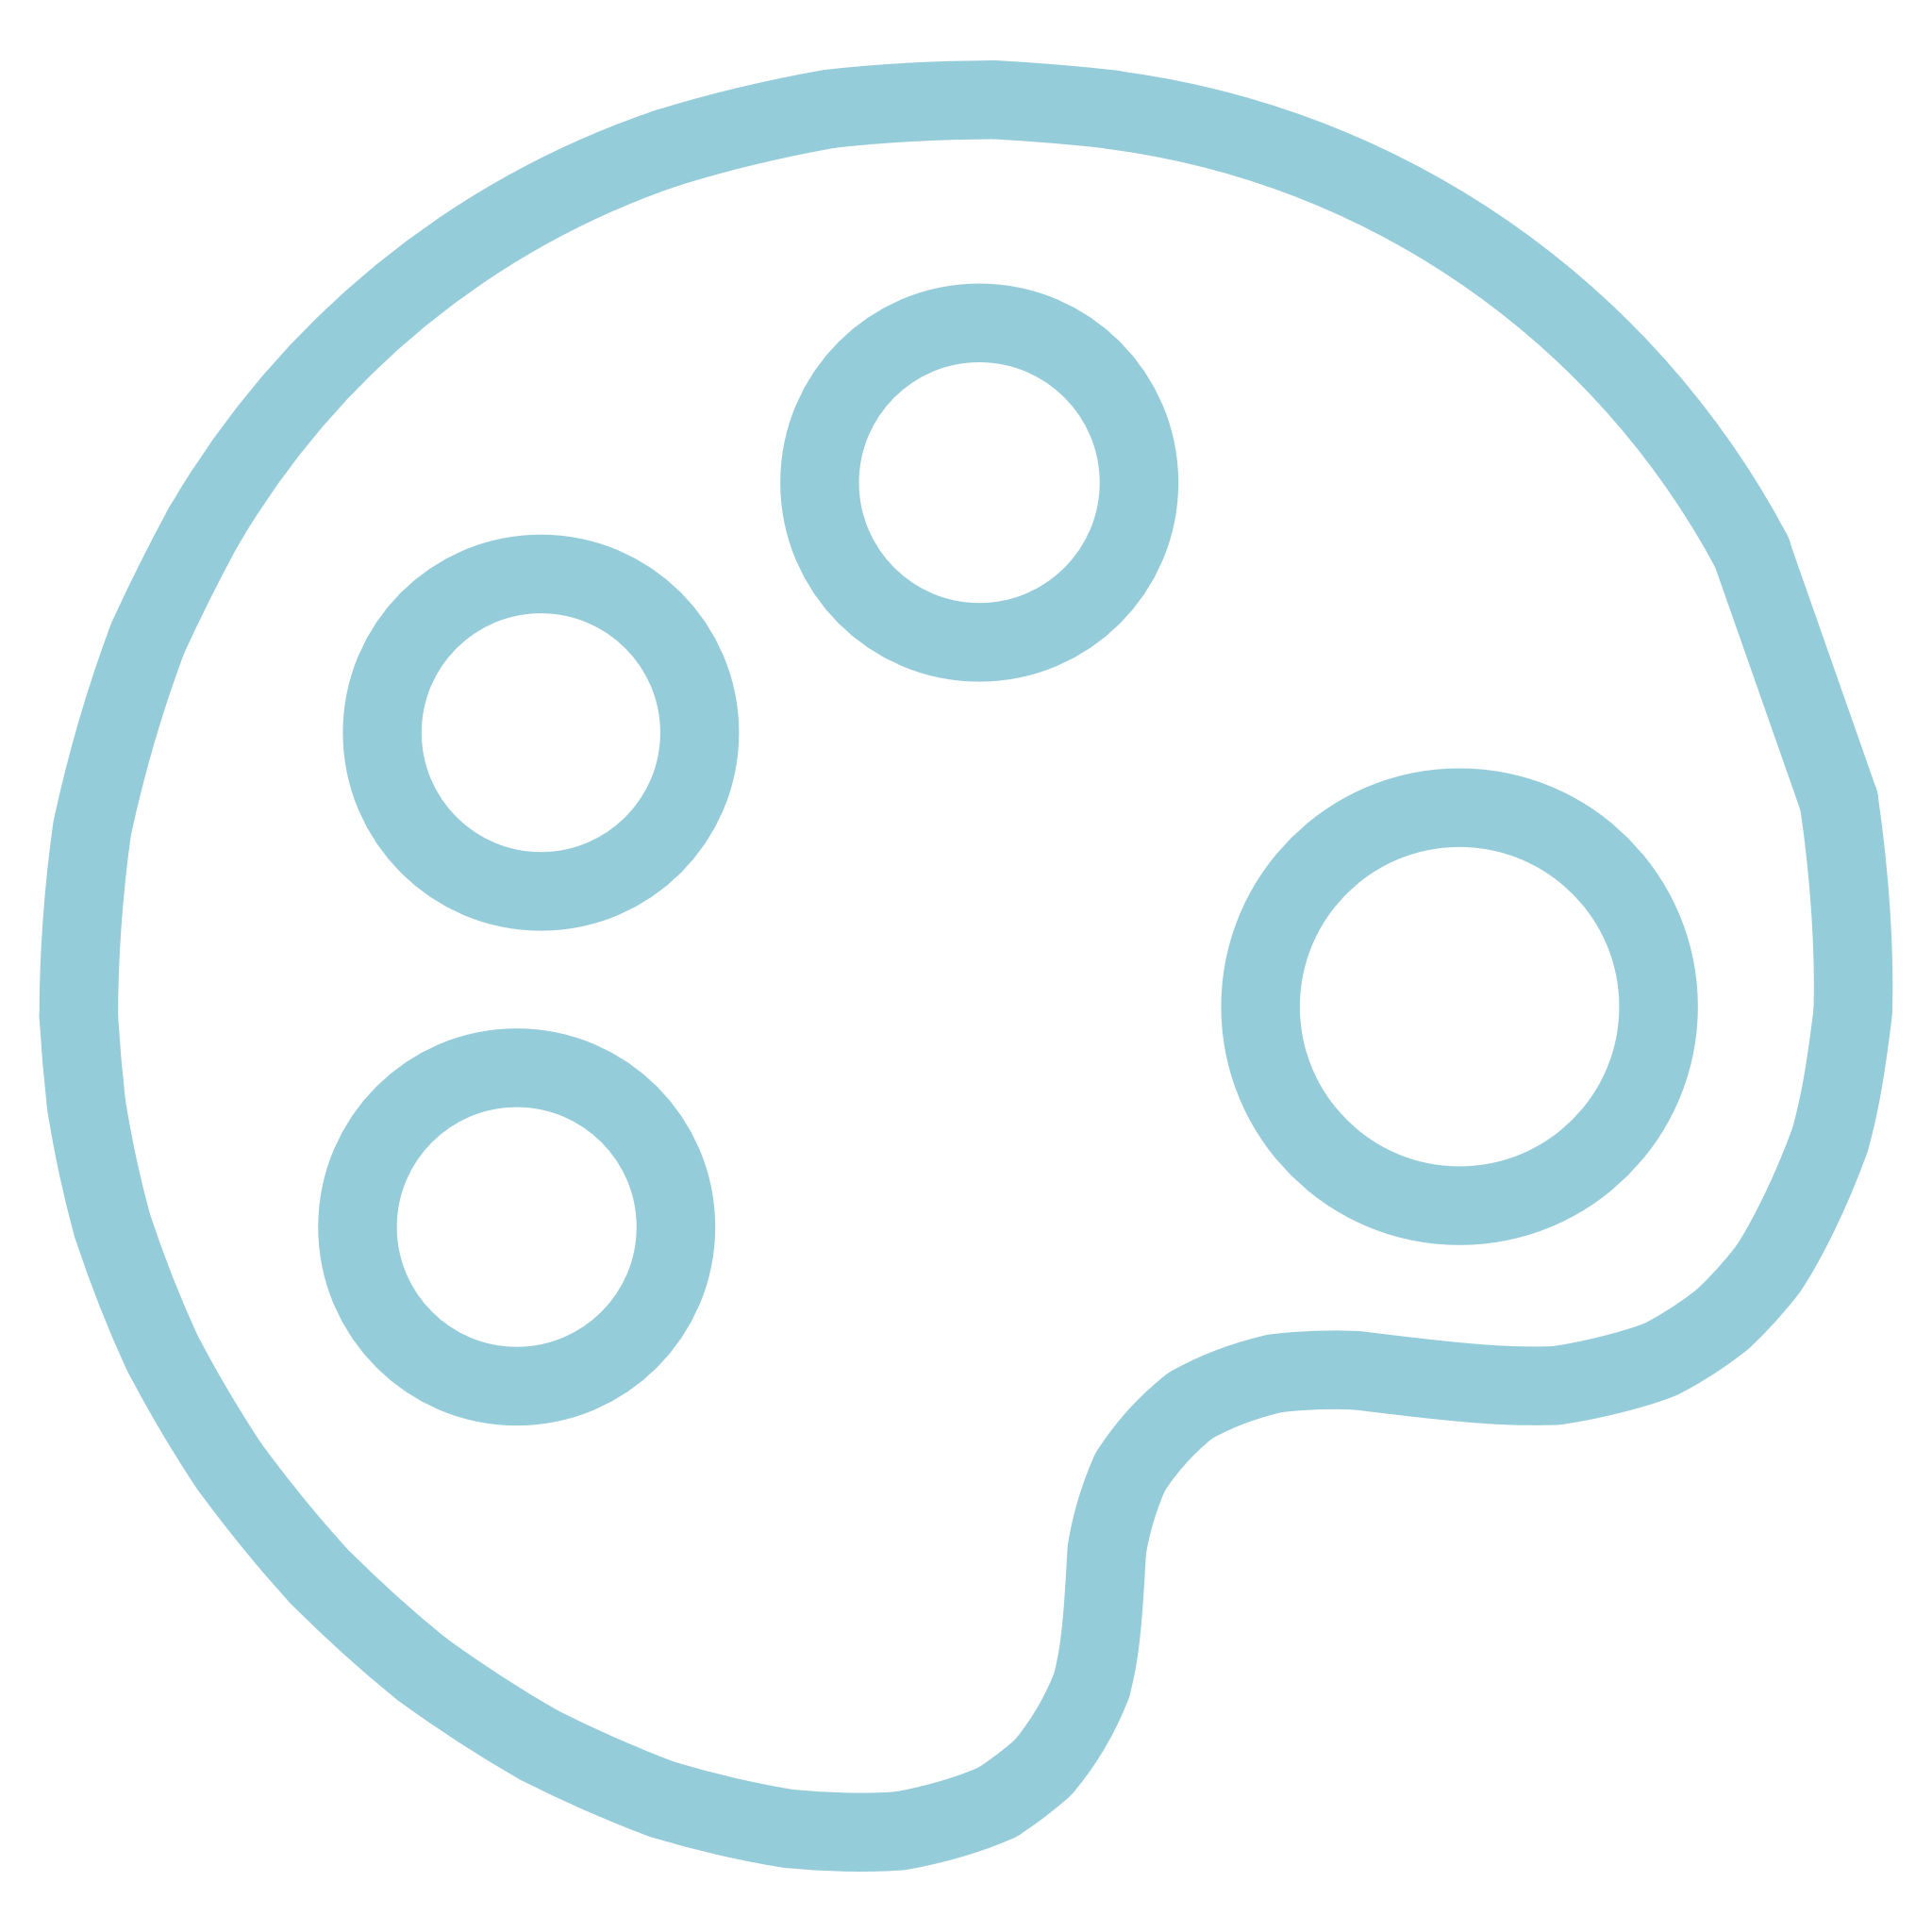
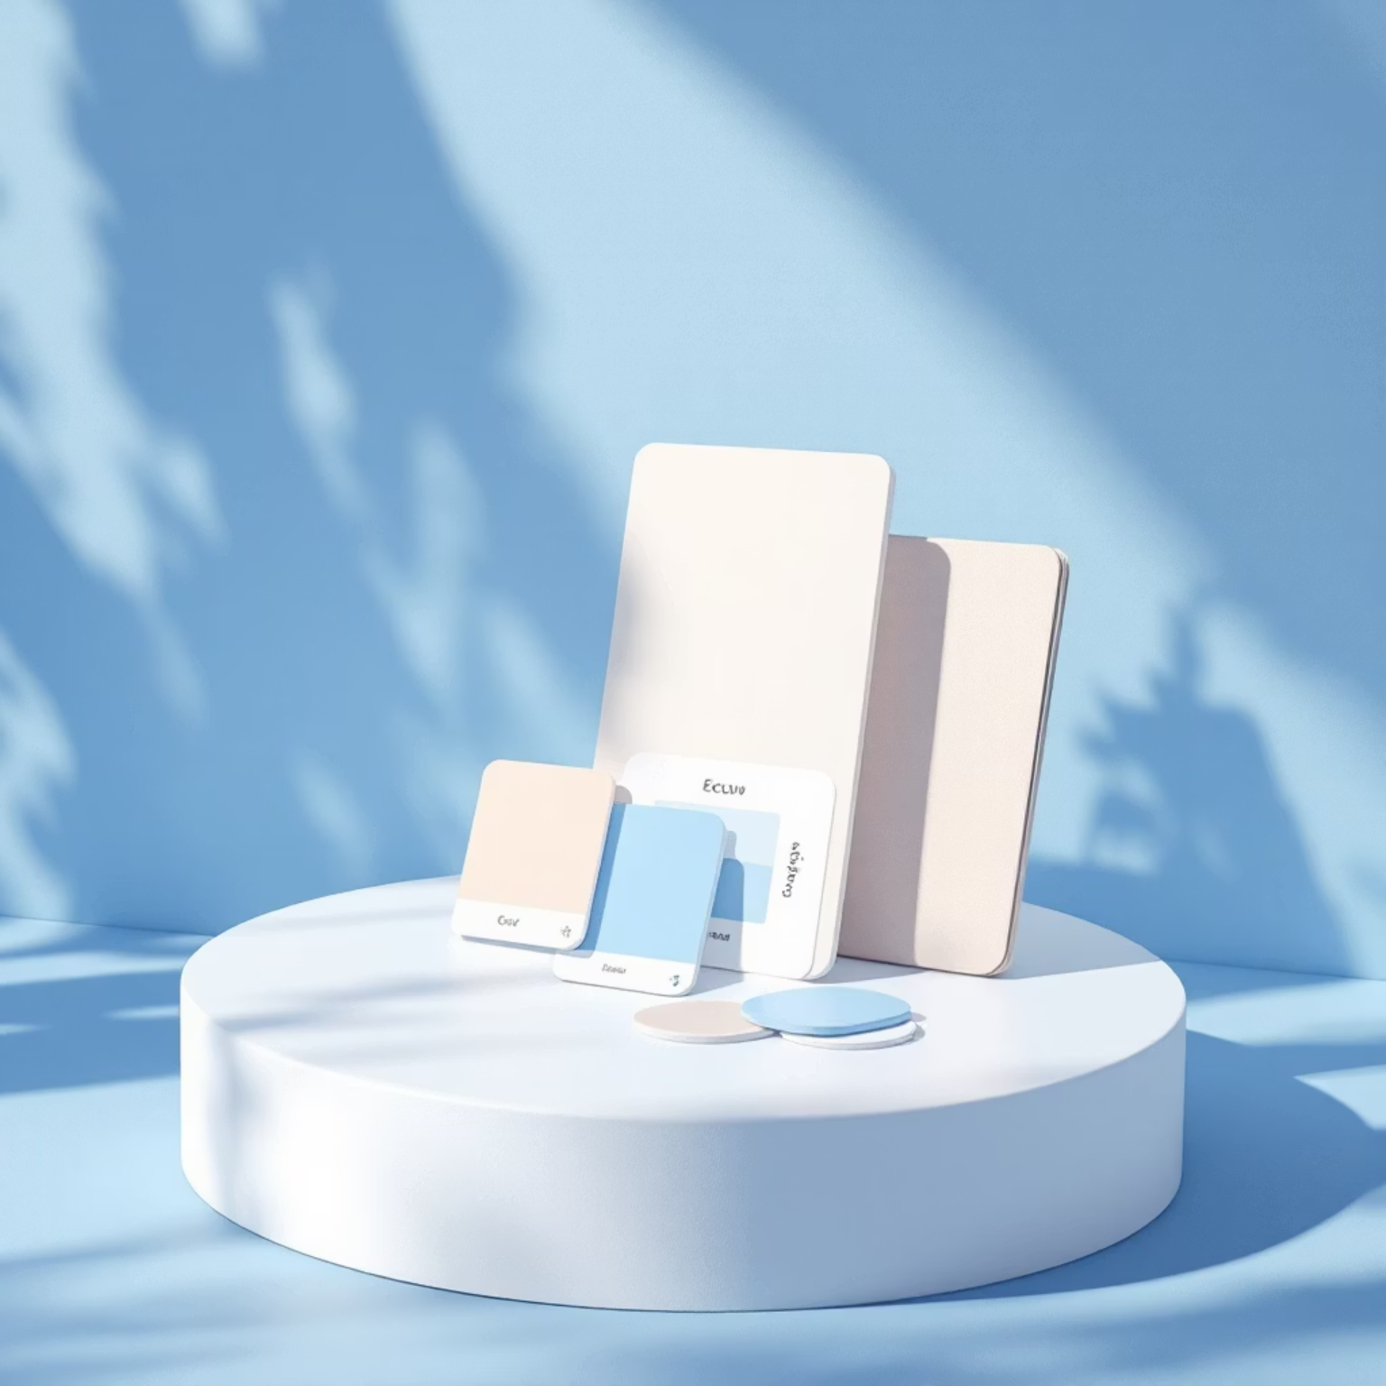



UI Design System
Professional Minimal Theme
A sophisticated design language that balances aesthetics with functionality, creating an environment where users can focus on their work rather than the interface.
Color System
Neutral shades with strategic blue accents for focus and clarity
Typography
Clean sans-serif fonts like Inter ensure optimal readability across all screen sizes
Visual Elements
Rounded tiles and card-based layouts with distinct status indicators

Slide 9
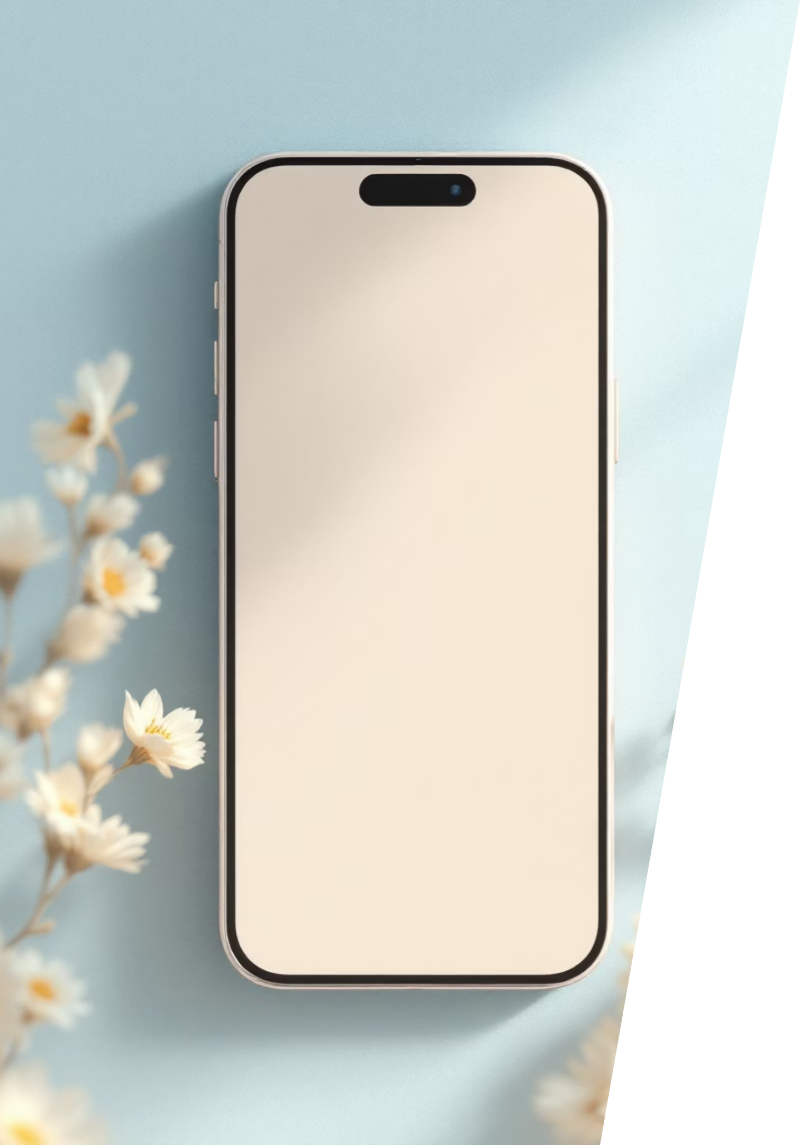


Prototype & Interactions
Intuitive Gestures & Micro-Animations
Drag & Drop
Reorder tasks naturally by dragging them into new positions
Swipe Left → Delete
Quick gesture to remove completed or irrelevant tasks
Swipe Right → Complete
Satisfying motion to mark tasks as done
Micro-Animations
Subtle feedback that creates moments of delight and productivity satisfaction
92%
Faster Workflow
Users reported significantly improved task completion speed

Slide 10




Conclusion
Mission Accomplished
The redesign successfully transforms task management from a source of stress into a productivity powerhouse. Through user-centered design principles, we created a streamlined workflow and visually low-stress environment that empowers users to focus on what truly matters.
Key Outcomes
Reduced cognitive load through minimal design
Improved task completion with intuitive interactions
Enhanced user satisfaction with thoughtful micro-animations
Seamless calendar integration for better planning

